Slide 1
Visual Setup Guide
PABV Ventilator
Version 1.0

Slide 2
Table Of Contents
Unpacking and taking inventory
Setup Pneumatics
From regulated “hospital air” or compressor
From high pressure cylinder bottle
Setup Patient Circuit
Setup Electronics

Slide 3
1) Unpacking and Taking Inventory

Slide 4
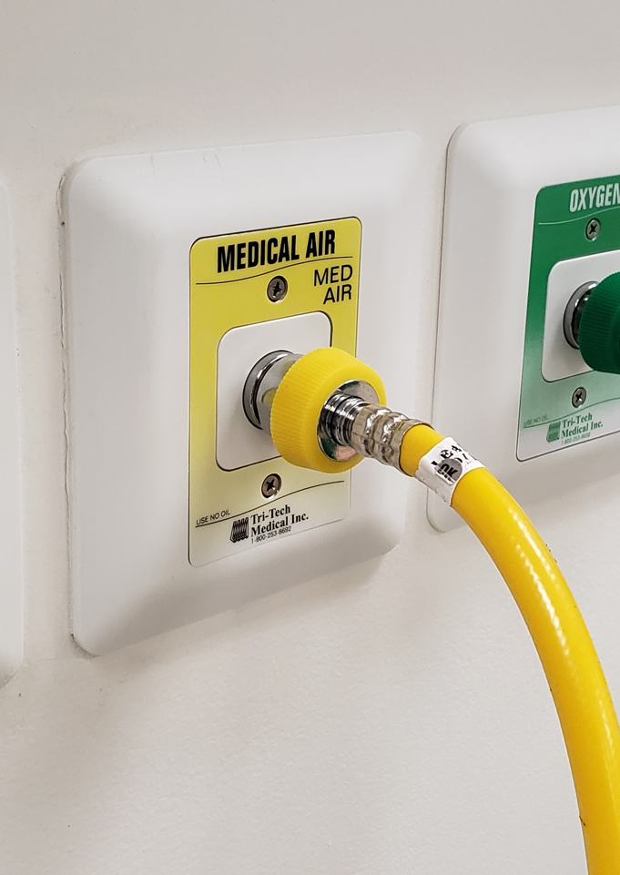
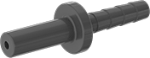
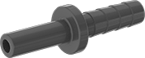
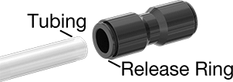
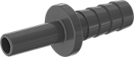
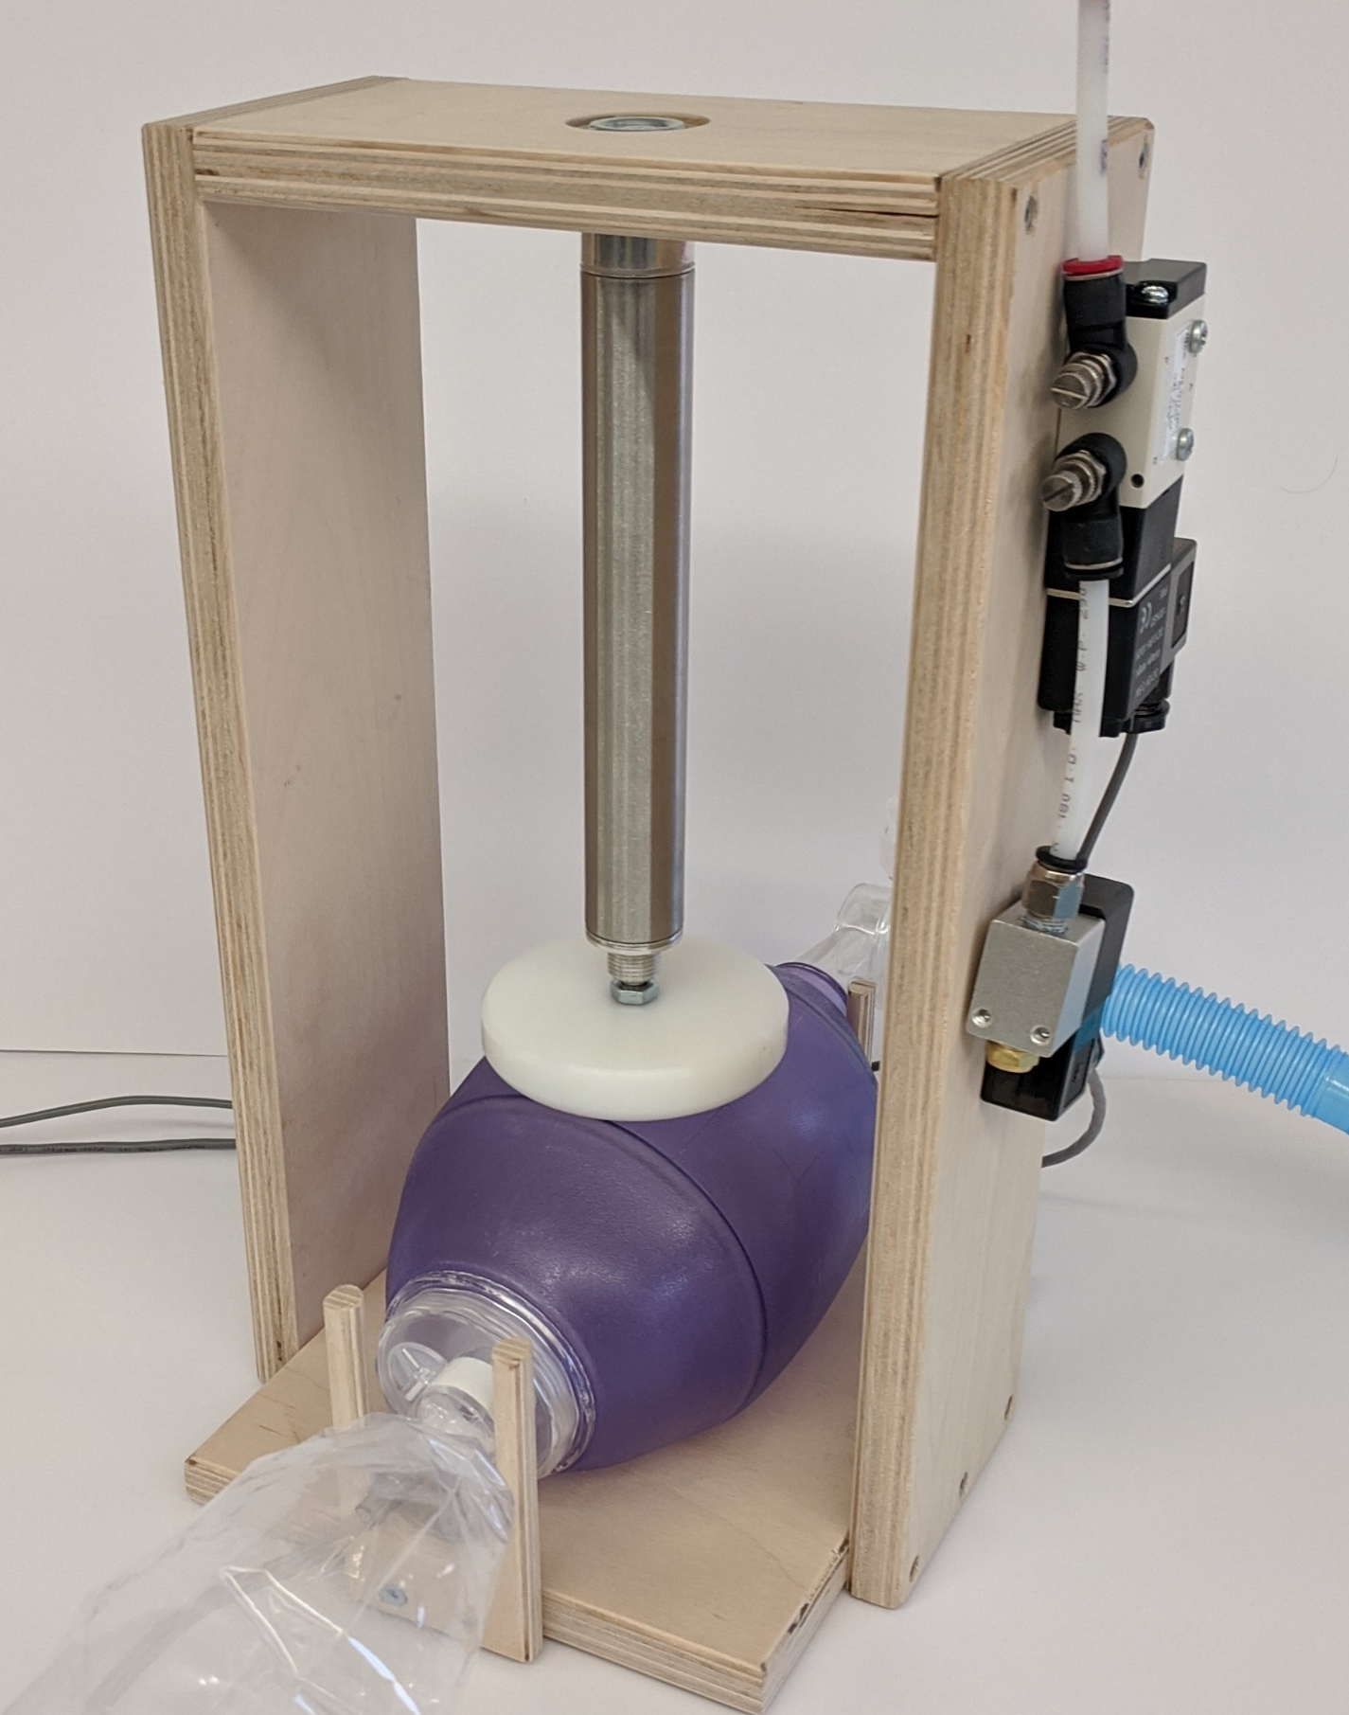
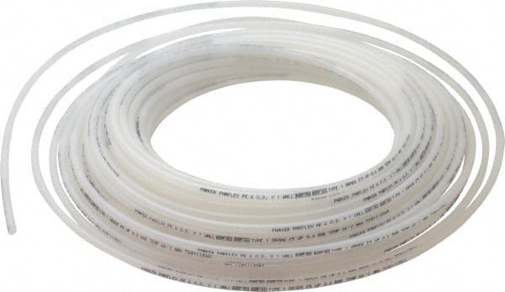
2.1) Connect pneumatic air supply to hospital air
Push to connect coupler
Adapt barb to Polyflow ¼” tube
Run Polyflow tube to RED input valve
Tubing
Release Ring
Input Pneumatic Air Supply
Needs 30-60 PSI
Choose the most appropriate barb to adapt your air supply to push-to-connect
Note: Make connection directly to wall LAST, do not use a flow regulator
Note: Cut Polyflow with razor blade against a hard surface

Slide 5
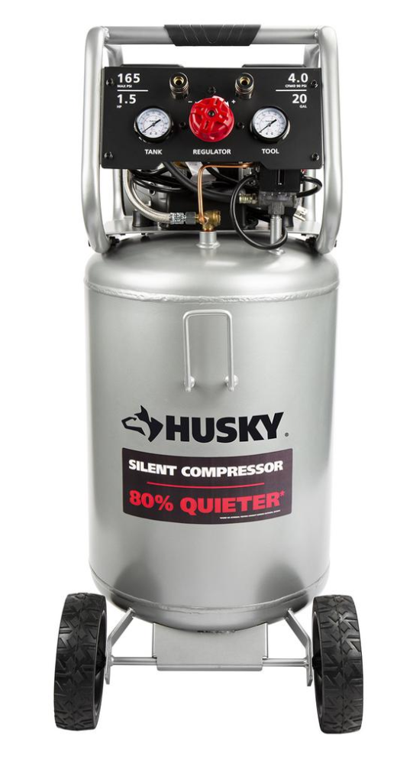
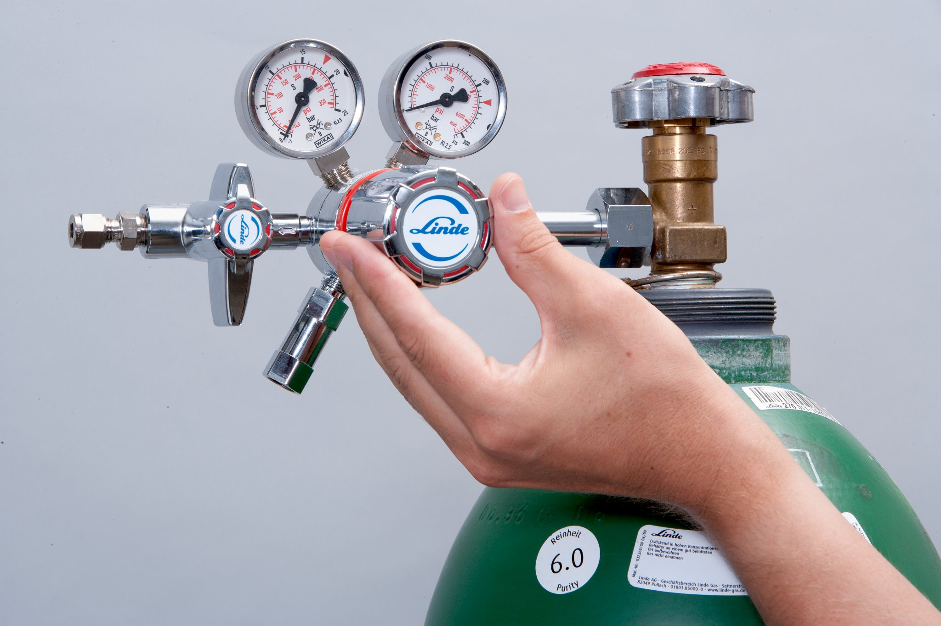
2.2) Connect pneumatic air supply to other
Input Pneumatic Air Supply
Needs 40-60 PSI
Run Polyflow tube to RED input valve
And/or
Note: Cut Polyflow with razor blade against a hard surface
Compressor output with sufficient capacity has regulated pressure output, set to 50 psi.
High pressure gas cylinders with regulator output, set to 50 psi.
Note: A failsafe backup is recommended and can be valved in using one-way check valves

Slide 6
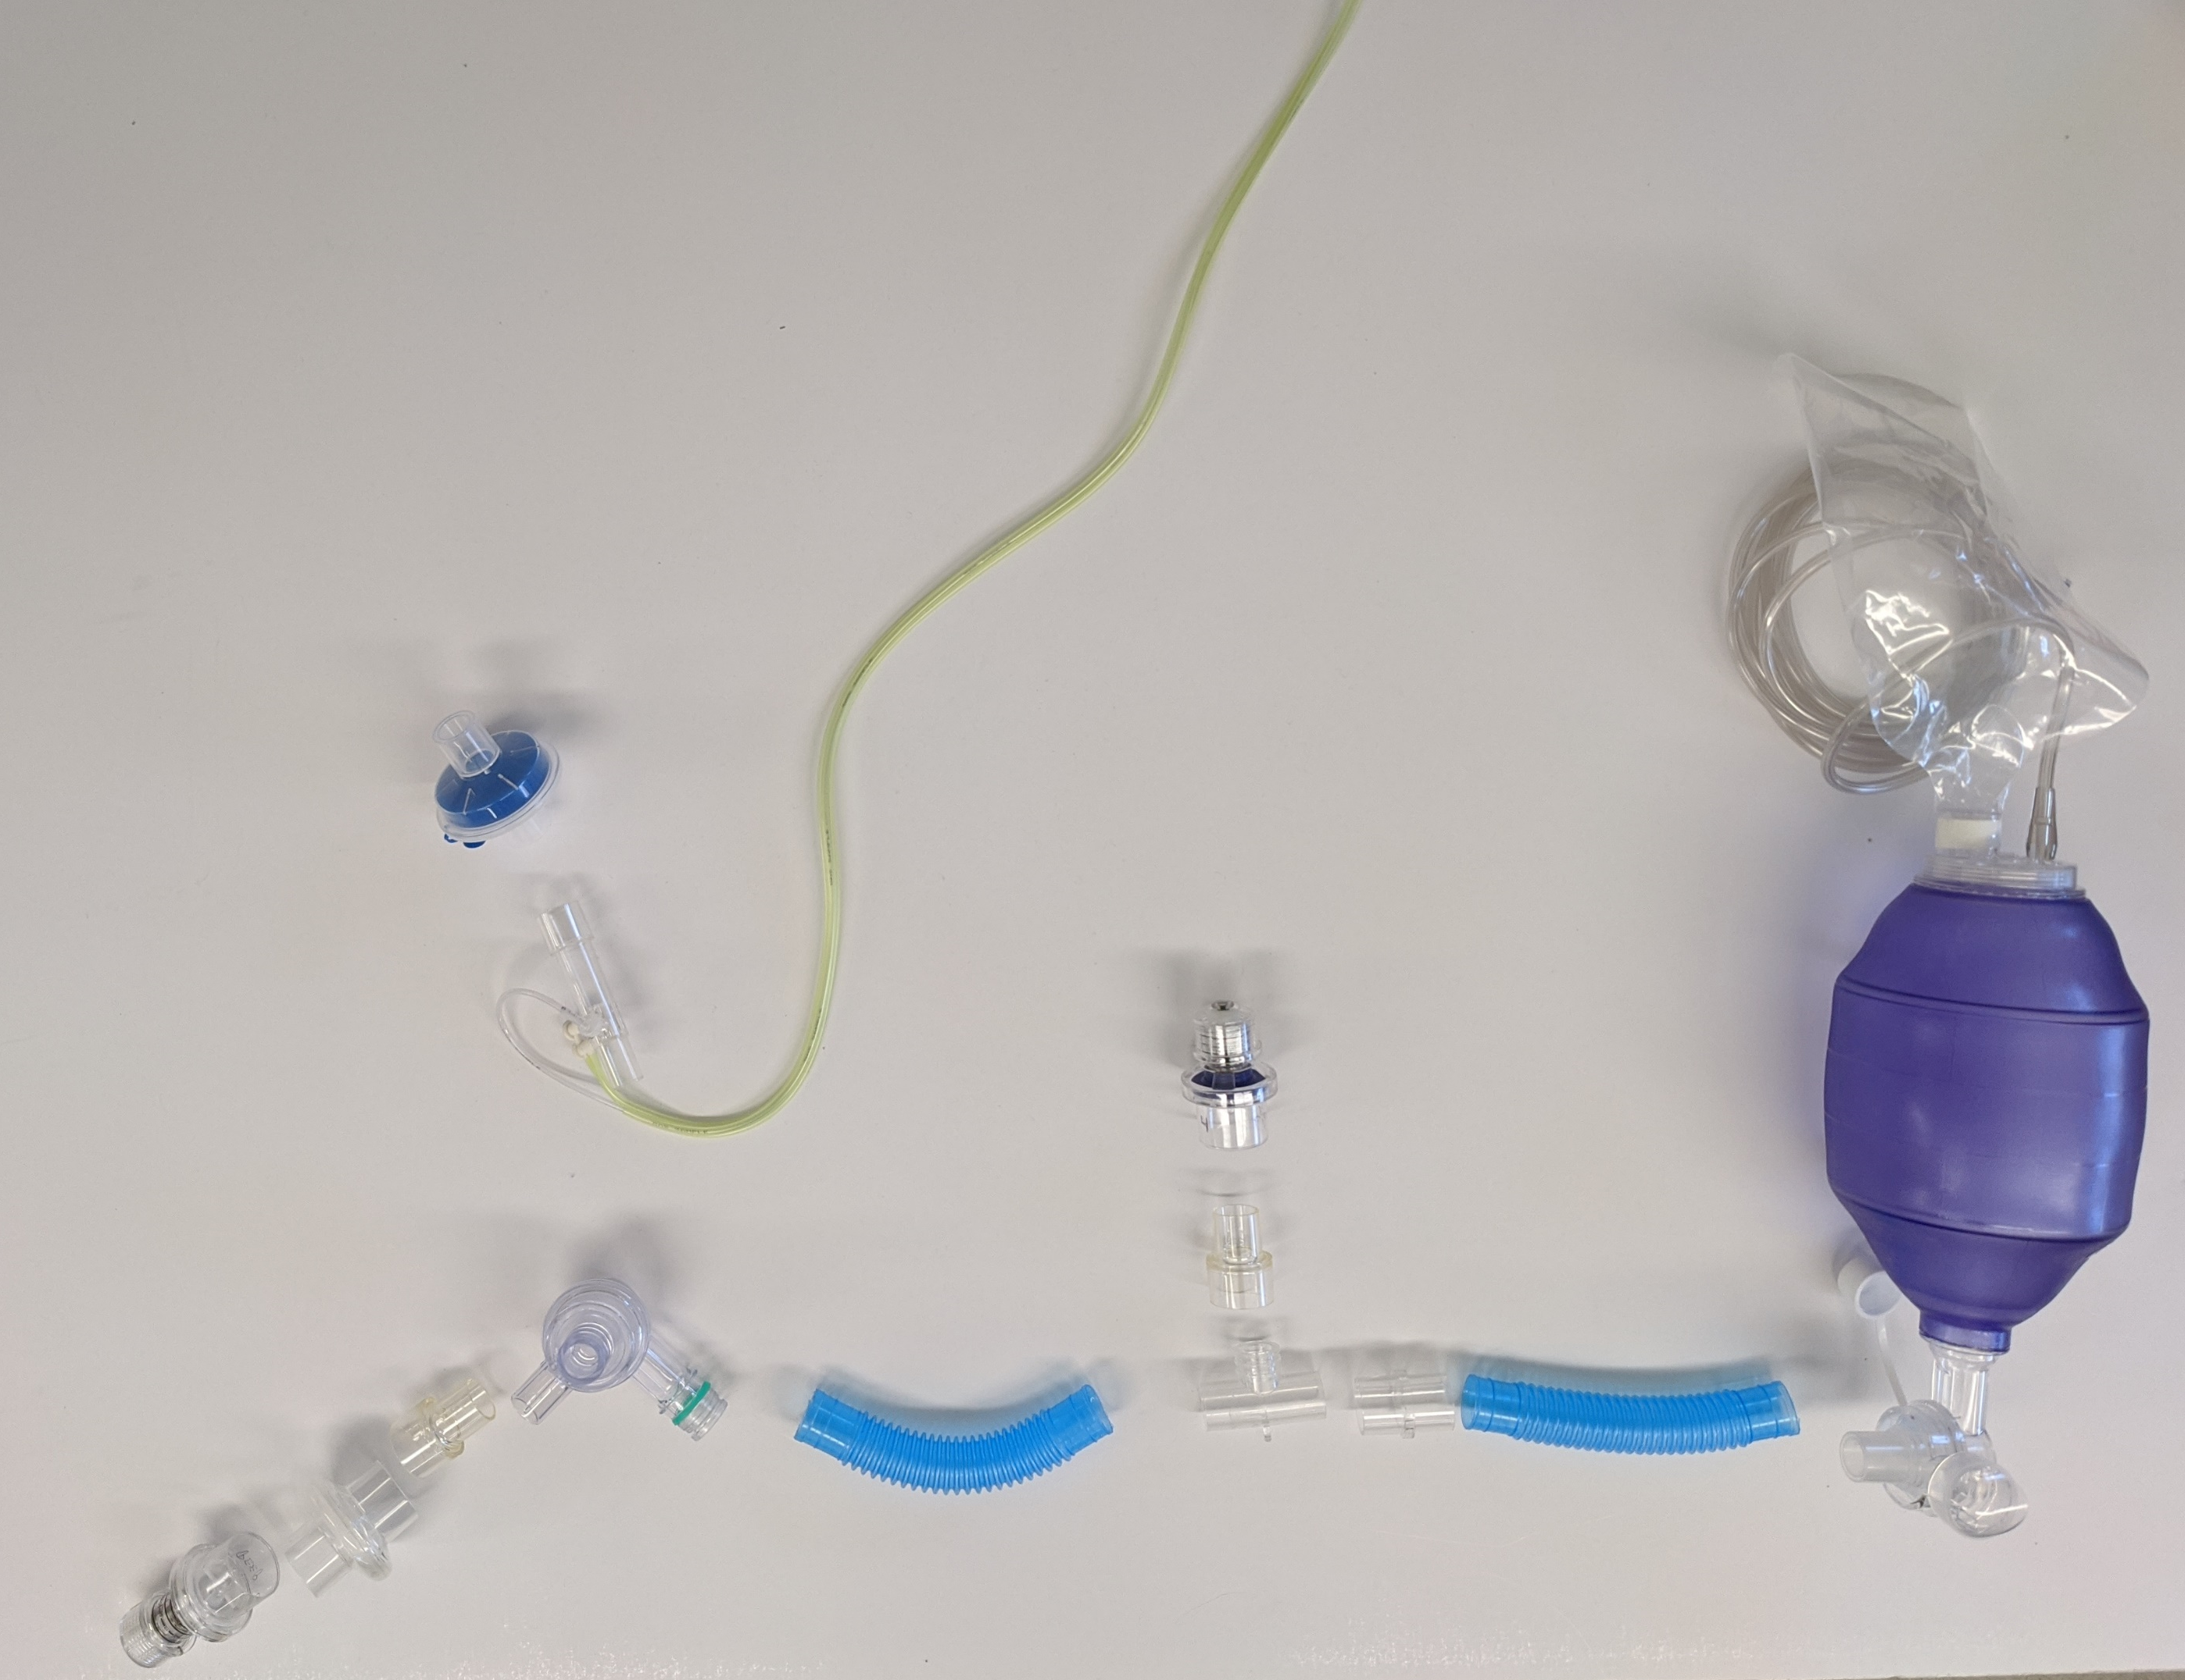
3) Patient Circuit
To Patient
Spirometer Sense Tubes
(to sensor box)
HME Filter
Spirometer
PIP Valve
Adaptor
HEPA Filter
MRI-Conditional Transport Ventilator Circuit
PEEP

Slide 7
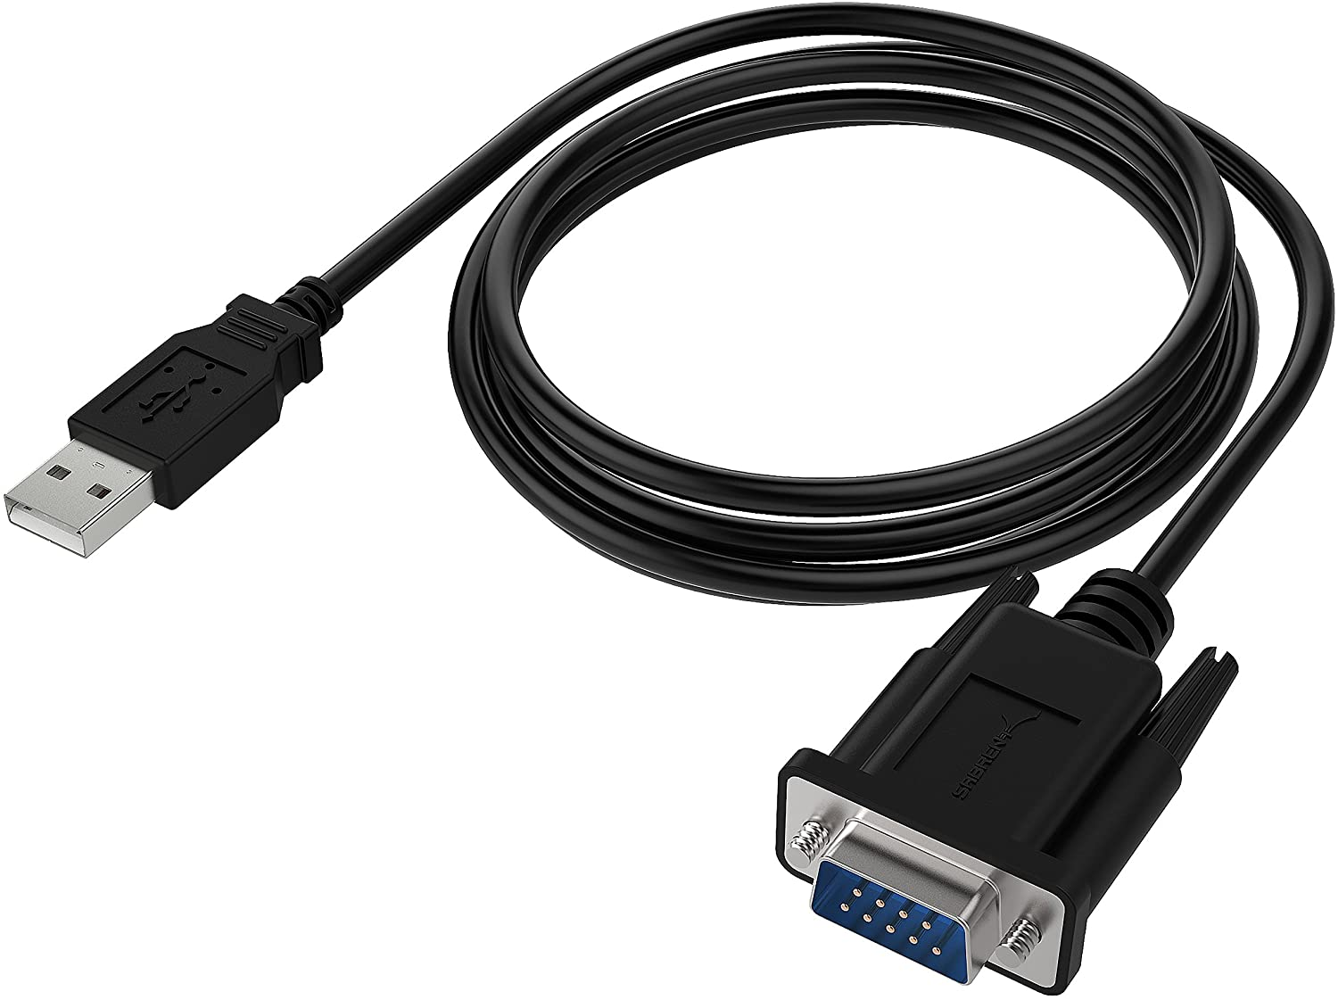
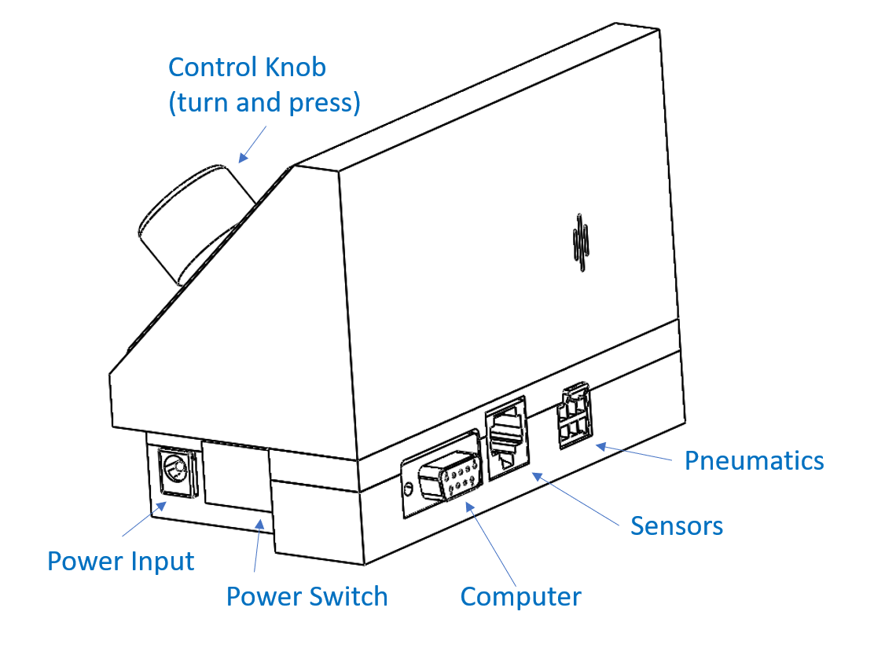
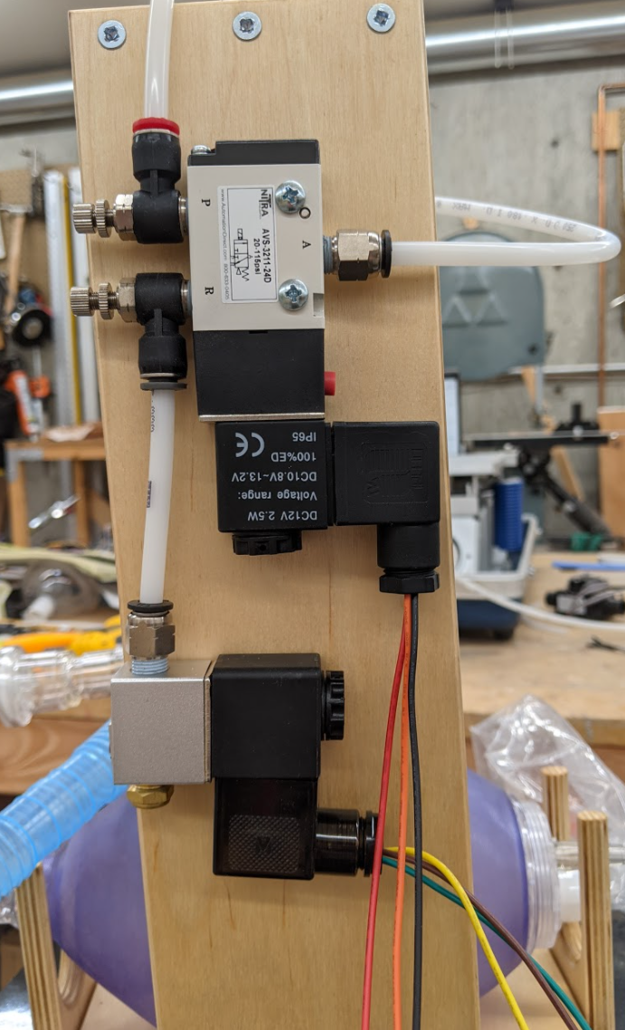
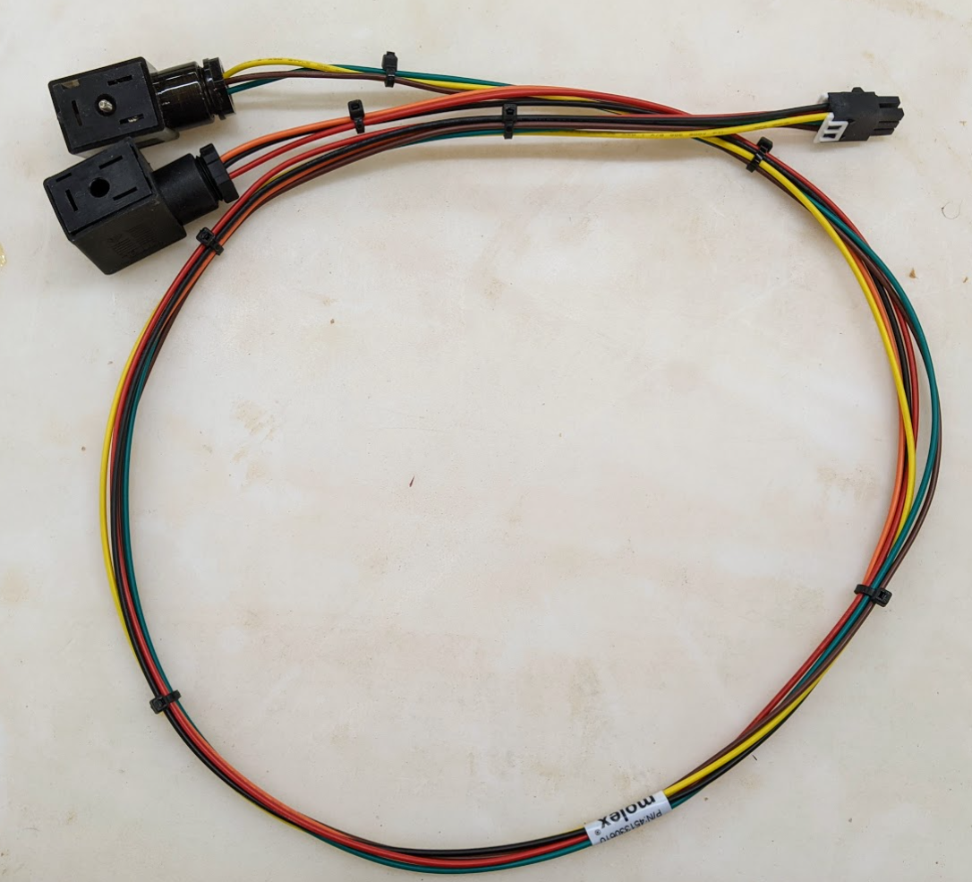
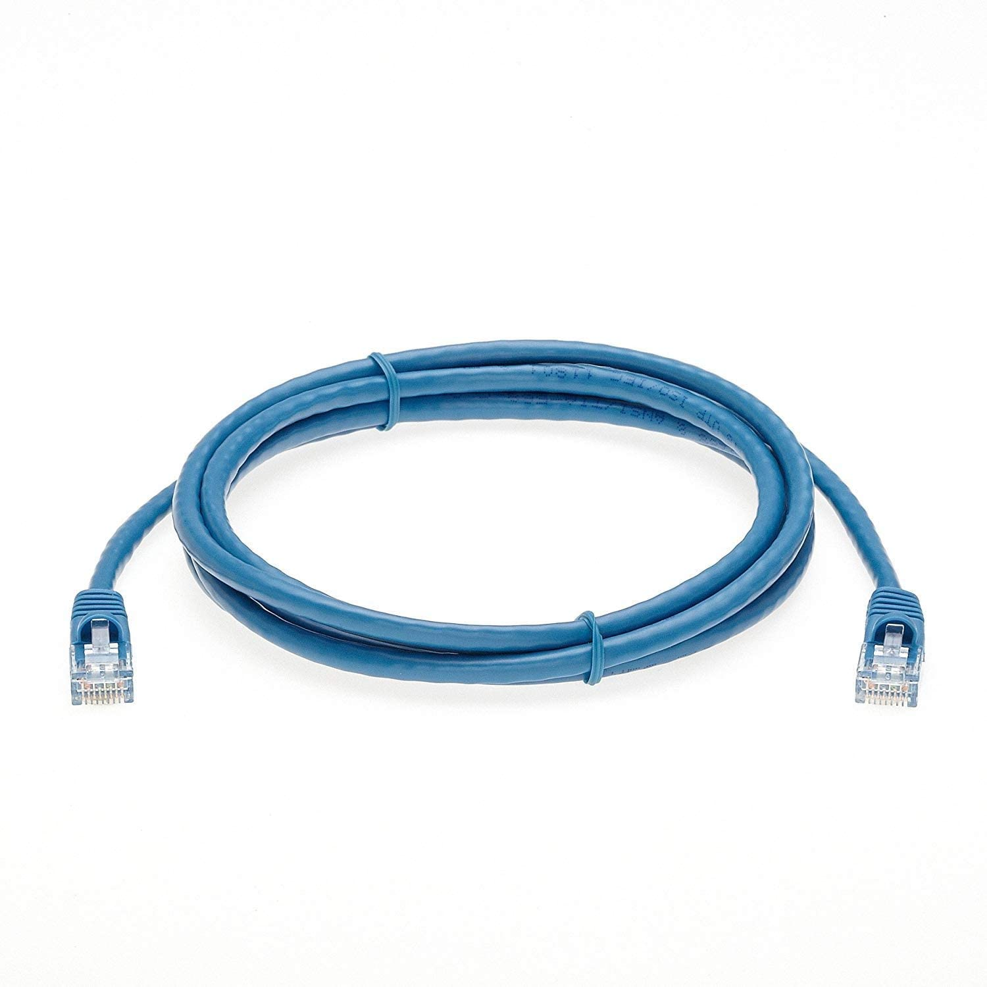
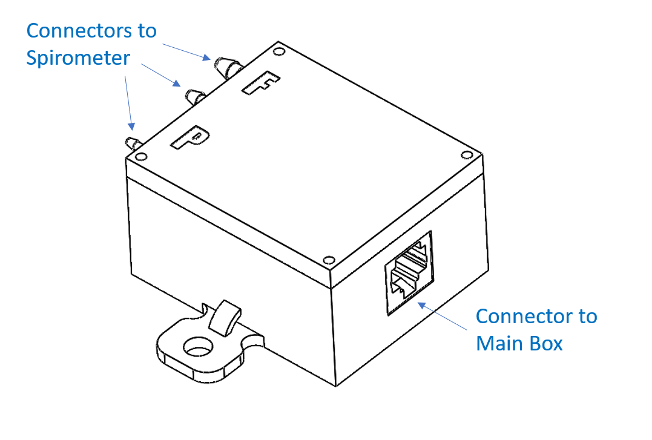
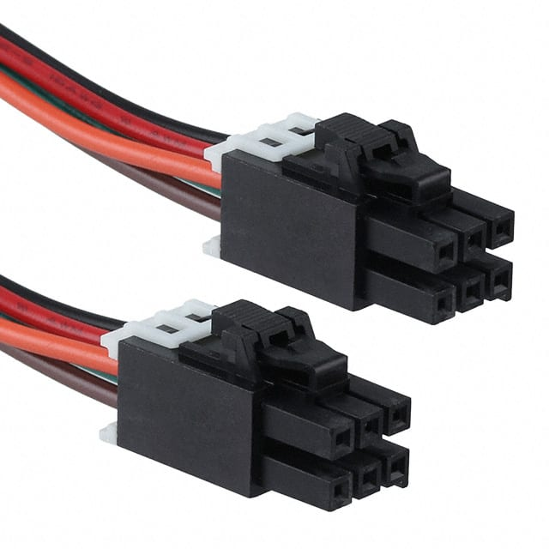
4) Setup Electronics
Computer Data Cable
Pneumatics cable
Sensor Box cable

